Slide 1
Intro to PowerShell for the DBAs
Automate your routine tasks with PowerShell

Slide 2
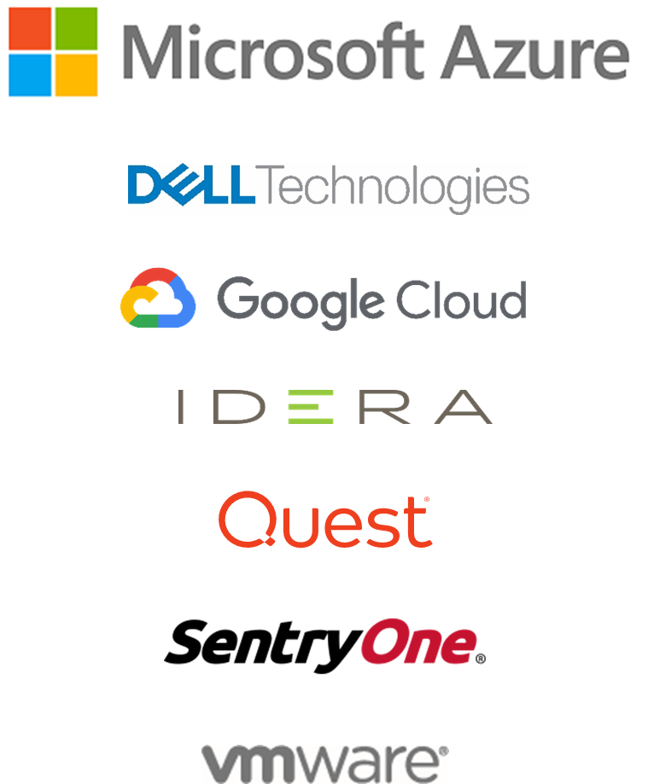
Thank you to our Global sponsors
SQL Saturday #997 Salt Lake City

Slide 3

We are thrilled to say the first ever PASS Virtual Summit will be taking place this November!
We will be launching PASS Summit into a whole new world, and with that comes exciting opportunities with what we can offer you. We will go beyond simply moving sessions online to fully embracing everything a virtual environment can offer.
Find out more at PASS.org/summit - Utah County SQL Group discount code - LGDIS6I0T ($50 off registration)

Slide 4
Harry Chandra
Database Administrator for 12+ years
Co-leader of the Redmond SQL User group
I noodle in: SQL Server, PowerShell, VMWare, Storage & more
Twitter: @harrychandrapdx
Website: harrychandra.com
Github: https://github.com/coolsekali/Presentations

Slide 5
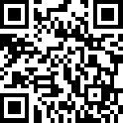
Pollev.com/harrychandra588

Slide 6
Agenda & Goals
The Basics
Module & cmdlet
Object, Method & Property
Using PowerShell to perform routine DBA tasks
Discover SQL instances
Check failed SQL Agent jobs
Check SQL Services status
Backup\restore
Goal
To get you started using PowerShell to manage SQL Server

Slide 7
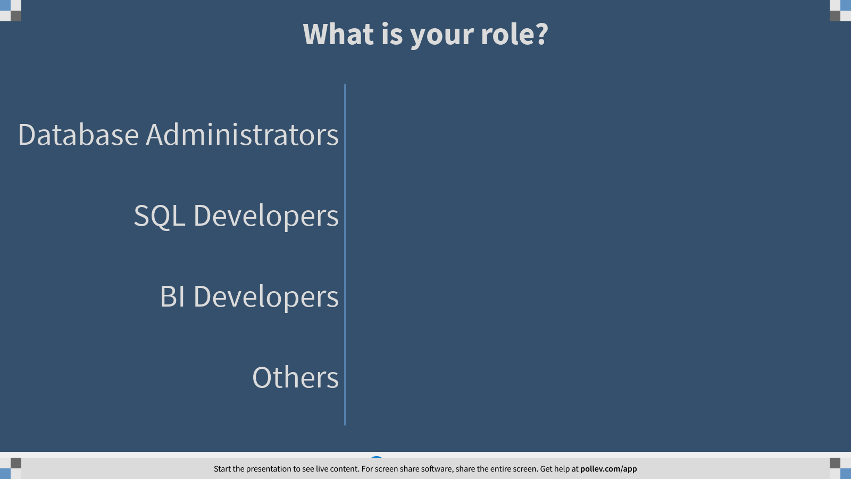
Notes:
Poll Title: What is your role? https://www.polleverywhere.com/multiple_choice_polls/hnieg24Dl7OKgDt9r0ANT?flow=Default&onscreen=persist

Slide 8
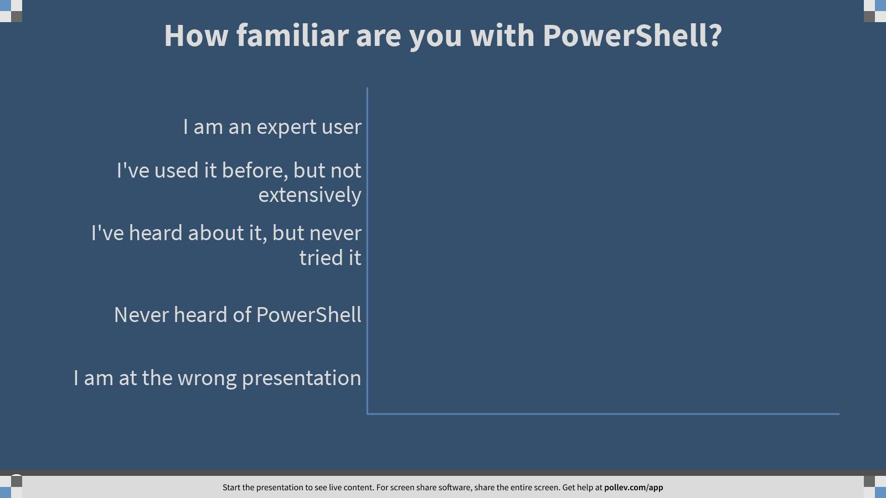
Notes:
Poll Title: How familiar are you with PowerShell? https://www.polleverywhere.com/multiple_choice_polls/t5ZEsPofK3MWxrGNipDk4?flow=Default&onscreen=persist

Slide 9
Why do DBA need to learn PowerShell…?

Slide 10
“if you have to do the same task multiple times, automate it!!...”
-- Someone very wise or lazy…… probably

Slide 11
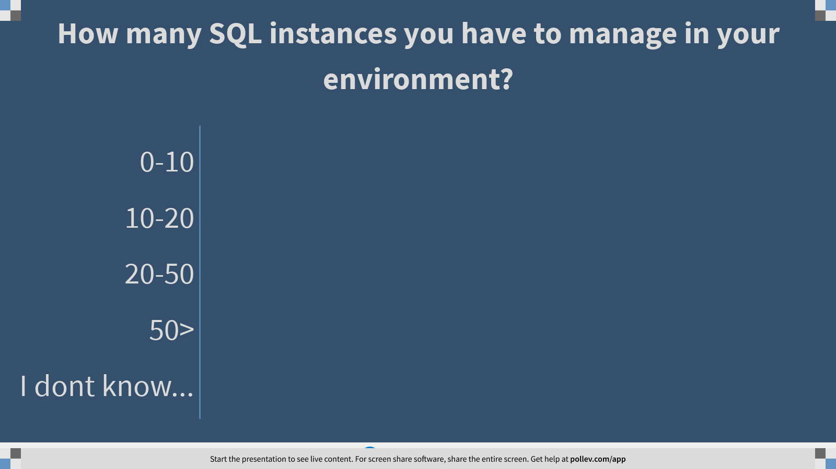
Notes:
Poll Title: How many SQL instances you have to manage in your environment? https://www.polleverywhere.com/multiple_choice_polls/z8amF5VhaTxveWfDuX3wT?flow=Default&onscreen=persist

Slide 12
What is PowerShell??

Slide 13
What is PowerShell?
Task-based command-line shell and scripting language built on .NET. PowerShell helps system administrators and power-users rapidly automate tasks that manage operating systems (Linux, macOS, and Windows) and processes.
Command line interface with Object-oriented output
Return object that can then be manipulated.
Pass object to another command, commonly called Piping by using “ | ”
PowerShell remoting use the same ports as WS-Man: 5985 & 5986

Slide 14
PowerShell – Modules and Cmdlets
Cmdlets (read: command-lets)
Cmdlet is a command use to invoke an action in PowerShell.
Examples: Get-service, Stop-computer, Write-Host
Modules
A collection of Cmdlets
Examples: SqlServer, DBATools, PoSHKeepass

Slide 15
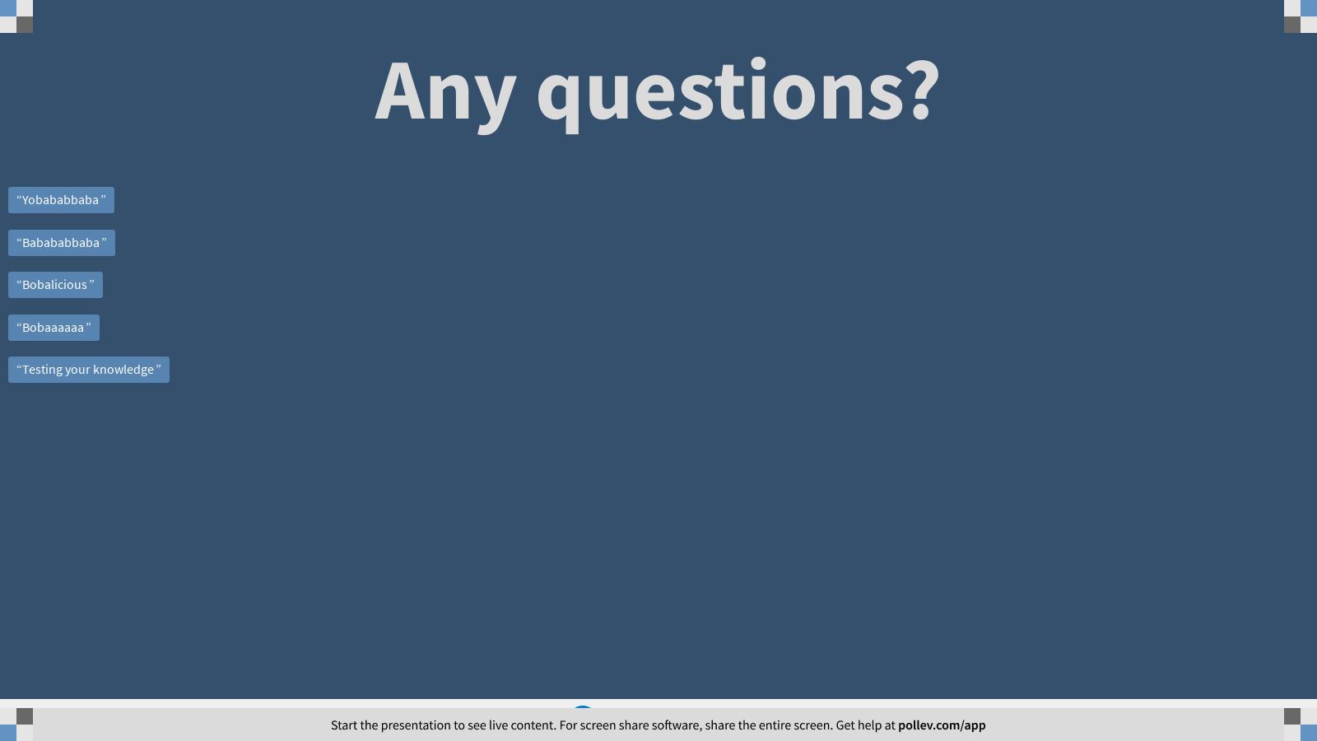
Notes:
Poll Title: Any questions? https://www.polleverywhere.com/free_text_polls/zoLaW6OePjqxIrkpVyo6M

Slide 16
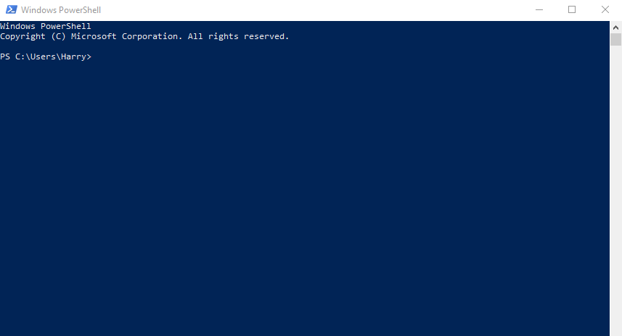
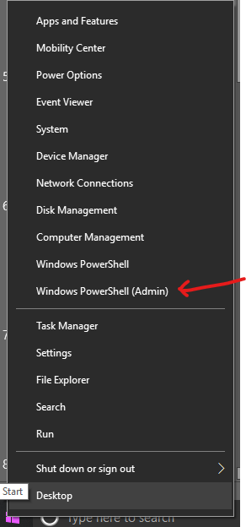
Tools - PowerShell Command Line
Command prompt equivalent for PowerShell
Standard shell as of Windows Server 2019

Slide 17
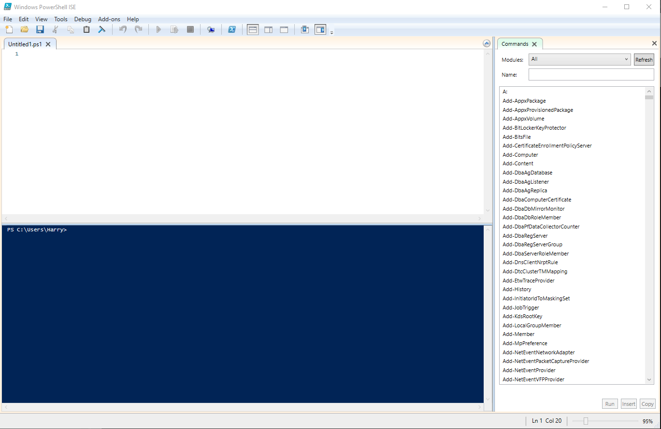
PowerShell Integrated Scripting Environment (ISE)
Part of OS installation with Windows Server 2012+, Windows 10+
Built-in PowerShell command line
Built-in Command browser
Simple UI

Slide 18
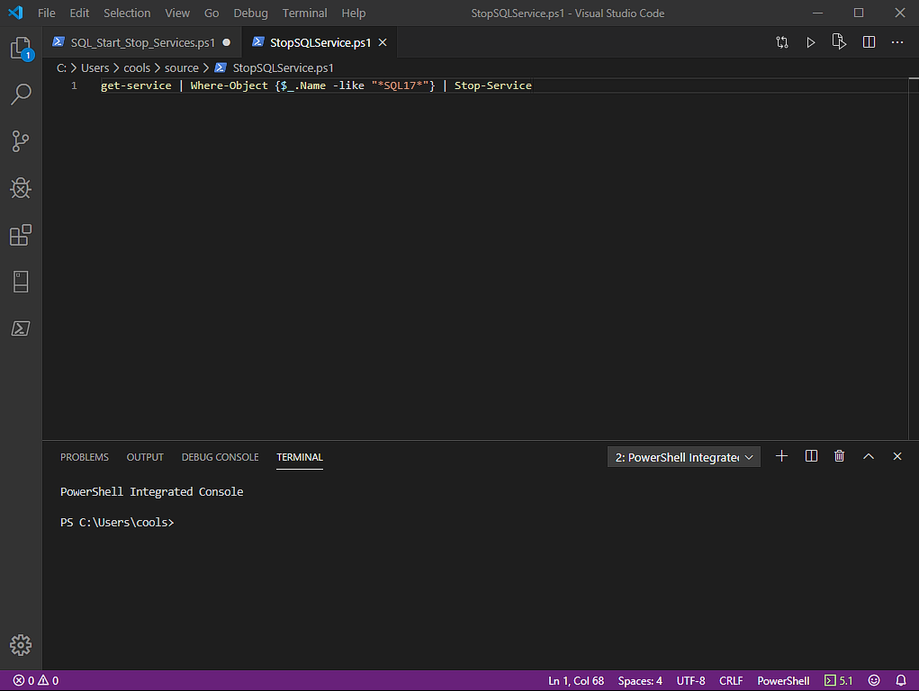
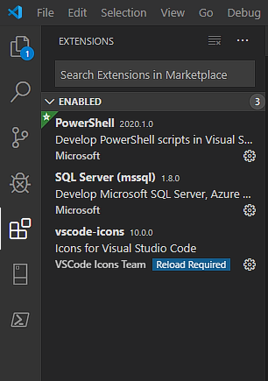
Tools - Visual Studio Code (with PowerShell extension)
Powerful scripting tool
Cross Platform (Windows, Linux, MacOS)
Extensible
Git Integration
Much much more…

Slide 19
Notes:
Poll Title: Any questions? https://www.polleverywhere.com/free_text_polls/zoLaW6OePjqxIrkpVyo6M

Slide 20
Demo
PowerShell 5.1, PowerShell ISE, SSMS

Slide 21
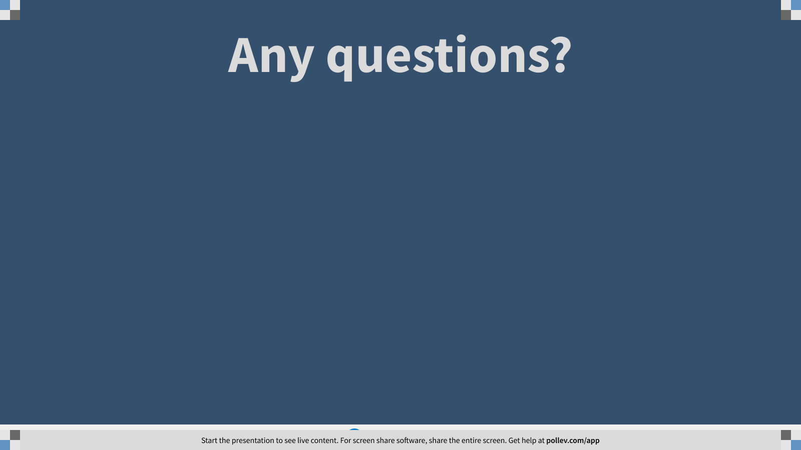
Notes:
Poll Title: Any questions? https://www.polleverywhere.com/free_text_polls/zoLaW6OePjqxIrkpVyo6M

Slide 22
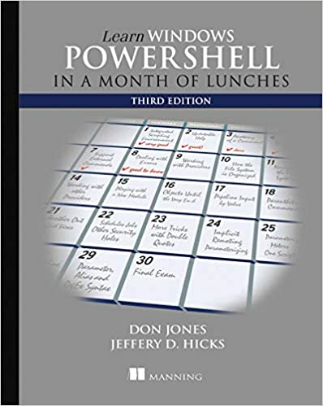
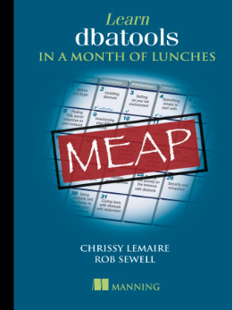
Recommended Books:

Slide 23
Session Evaluations
https://www.sqlsaturday.com/997/Sessions/Session-Evaluation
Alternatively go to the Schedule and click on the session you would like to give feedback on and click Session Evaluation

Slide 24
Resources
https://docs.microsoft.com/en-us/powershell/scripting/overview?view=powershell-7
https://devblogs.microsoft.com/scripting/ (The Scripting Guy)
https://sqldbawithabeard.com/ (Rob Sewell)
https://www.mssqltips.com/sqlservertip/2516/enable-powershell-remoting-on-sql-server-instances/
https://docs.microsoft.com/en-us/powershell/module/microsoft.powershell.core/about/about_execution_policies?view=powershell-7
https://docs.microsoft.com/en-us/powershell/module/sqlserver/?view=sqlserver-ps
https://docs.microsoft.com/en-us/archive/blogs/daviddasneves/powershell-security-at-enterprise-customers
https://dbatools.io/secure/
https://www.sqlservercentral.com/articles/basic-git-for-dbas-managing-powershell-scripts
https://devblogs.microsoft.com/scripting/get-started-with-powershell-development-in-visual-studio-code/

